Slide 1

Milestone 2 - Project Scope
Notes:
Evan

Slide 2
Our Team
ITI Solutions
Aidan C. - Team leader
Harley L. - Liaison officer
Justin A. - Database developer
Beryon C. - Server engineer/UX
Evan G. - Programmer/UX
Notes:
Everyone

Slide 3
business requirements
Business requirements include:
Track hours & classification(s) of employees
Warn against and/or prevent overscheduling
Receive signatures to verify hours worked by employees.
Notes:
Harley

Slide 4
user requirements
User requirements include:
Functionality to fill forms in interfacing device
Ensure information about workers is distributed to managers
Notes:
Harley

Slide 5
functional requirements
Functional requirements include:
Allow importing/exporting of data
Manage and verify data in the system
Manage scheduling and notify users when conflicts arise
Notes:
Evan

Slide 6
Non-functional requirements
Non-functional requirements include:
Compliance with FOIP, PIPEDA, and other privacy legislation
Notes:
Evan

Slide 7
system requirements
System requirements include:
This system will need a database, web server, website, and scripts to process the data
Notes:
Evan

Slide 8
Project Scope
Overall, this system is meant to assist Edenbridge in scheduling employees as well as track hours in a more accurate manner
This is done across two major software components
Notes:
Aidan

Slide 9
Project Scope - Scheduling
The first major segment of the proposed system will allow for coordinators to book employees
Will alert coordinator in the event an employee has been double booked or will cause the employee to be working overtime
Notes:
Aidan

Slide 10
Project Scope – Shift Tracking
The other portion of the system deals with the tracking and management of the hours and related data about an employee’s work.
System will alert payroll workers about errors/conflicts that are present
Automatic verification of data will allow most issues to be resolved prior to the completion of payroll
Notes:
Aidan

Slide 11
Project scope - Users
System Users
Main users are coordinators and payroll workers
Main users for the new system will also include employees
Notes:
Justin

Slide 12
Project scope – Policies & Procedures
Edenbridge employs the following policies and procedures:
When they work with children, parents must sign off on services
Workers hand in and sign physical timesheets for verification
Current scheduling is done by coordinators consulting a binder of employees
Notes:
Justin

Slide 13
Project scope – Physical Area
The physical layout of Edenbridge:
Reception, offices, and a boardroom on the main floor
Offices and counselling/therapy rooms on the second floor, as well as the server room
Each office has at least one computer, mostly running Windows 10
Notes:
Justin

Slide 14
Project timeline
At present, the timeline running through to early December allocates roughly 2 weeks per Milestone
8 days average per Lessons Learned
3-4 meetings per Milestone, including those with the client
Notes:
Beryon

Slide 15
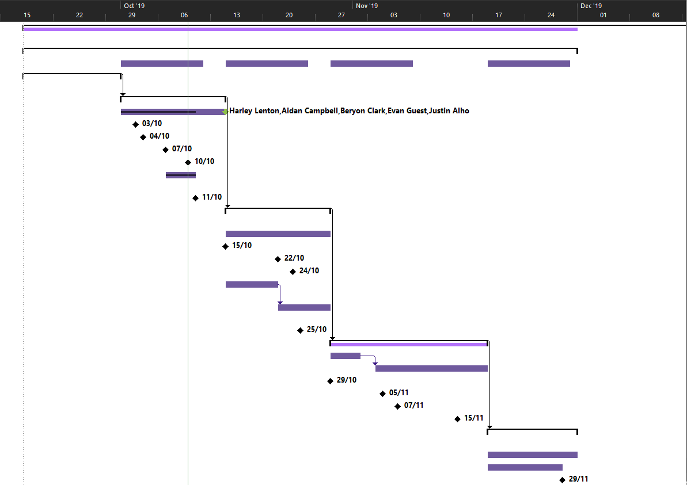
Notes:
Beryon

Slide 16
Project timeline – Looking forwards
Into the Future:
Evaluation of Edenbridge’s current processes and the interconnections between them
Establishing the process flow of the system to be proposed
Establish ERDs of the proposed system to begin building a framework for the proposal
Notes:
Beryon

Slide 17
Questions?

